Slide 1

SDLC | AGILE
SCRUM
Jon-Kayla Pointer
Southern New Hampshire University

Slide 2
SDLC
Waterfall (Traditional) or Agile Scrum?

Slide 3
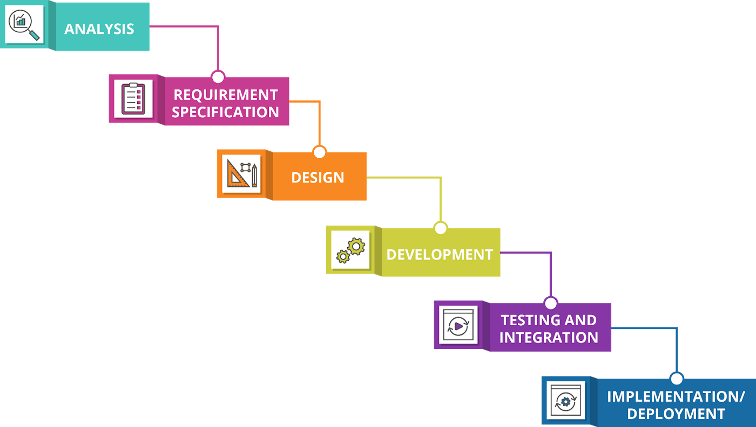
Waterfall (Traditional)
The waterfall model takes a sequential and linear approach; it is step by step process when developing a system.
Waddell, J. +. (2019, April 23). The cascading costs of Waterfall. Medium. Retrieved August 11, 2022, from https://medium.com/@joneswaddell/the-cascading-costs-of-waterfall-5c3b1b8beaec

Slide 4
Waterfall (Traditional)
Suited for short, low-cost, clearly defined product backlogs projects
PROS: SIMPLE AND EASY TO IMPLEMENT
CONS: NO ADAPTABILTY; INABILITY TO GO BACK TO A PREVIOUS PHASE
Waddell, J. +. (2019, April 23). The cascading costs of Waterfall. Medium. Retrieved August 11, 2022, from https://medium.com/@joneswaddell/the-cascading-costs-of-waterfall-5c3b1b8beaec

Slide 5
AGILE
The Agile Methodologies an approach in SDLC that takes the project and breaks it into several phases.
Involves collaboration with stakeholders, product owners, developers, and even end-users of the product.
Best suited for projects that are large, or the vision of the product is not as clear.

Slide 6
AGILE (CONT.)
The term Agile Methodology isn’t just a singular approach, it is more of a philosophy that developers may choose to implement in the SDLC.
Many different types of Agile ie: Kanban, Extreme Programming, and Scrum
All the types of Agile Methodologies share the same twelve principles and core values found in the Agile Manifesto.

Slide 7
SCRUM
This approach utilizes the collaboration of multiple small teams in an intensive and interdependent manner
This framework takes iterations called sprints.
Utilizes Scrum Roles to ensure success.

Slide 8
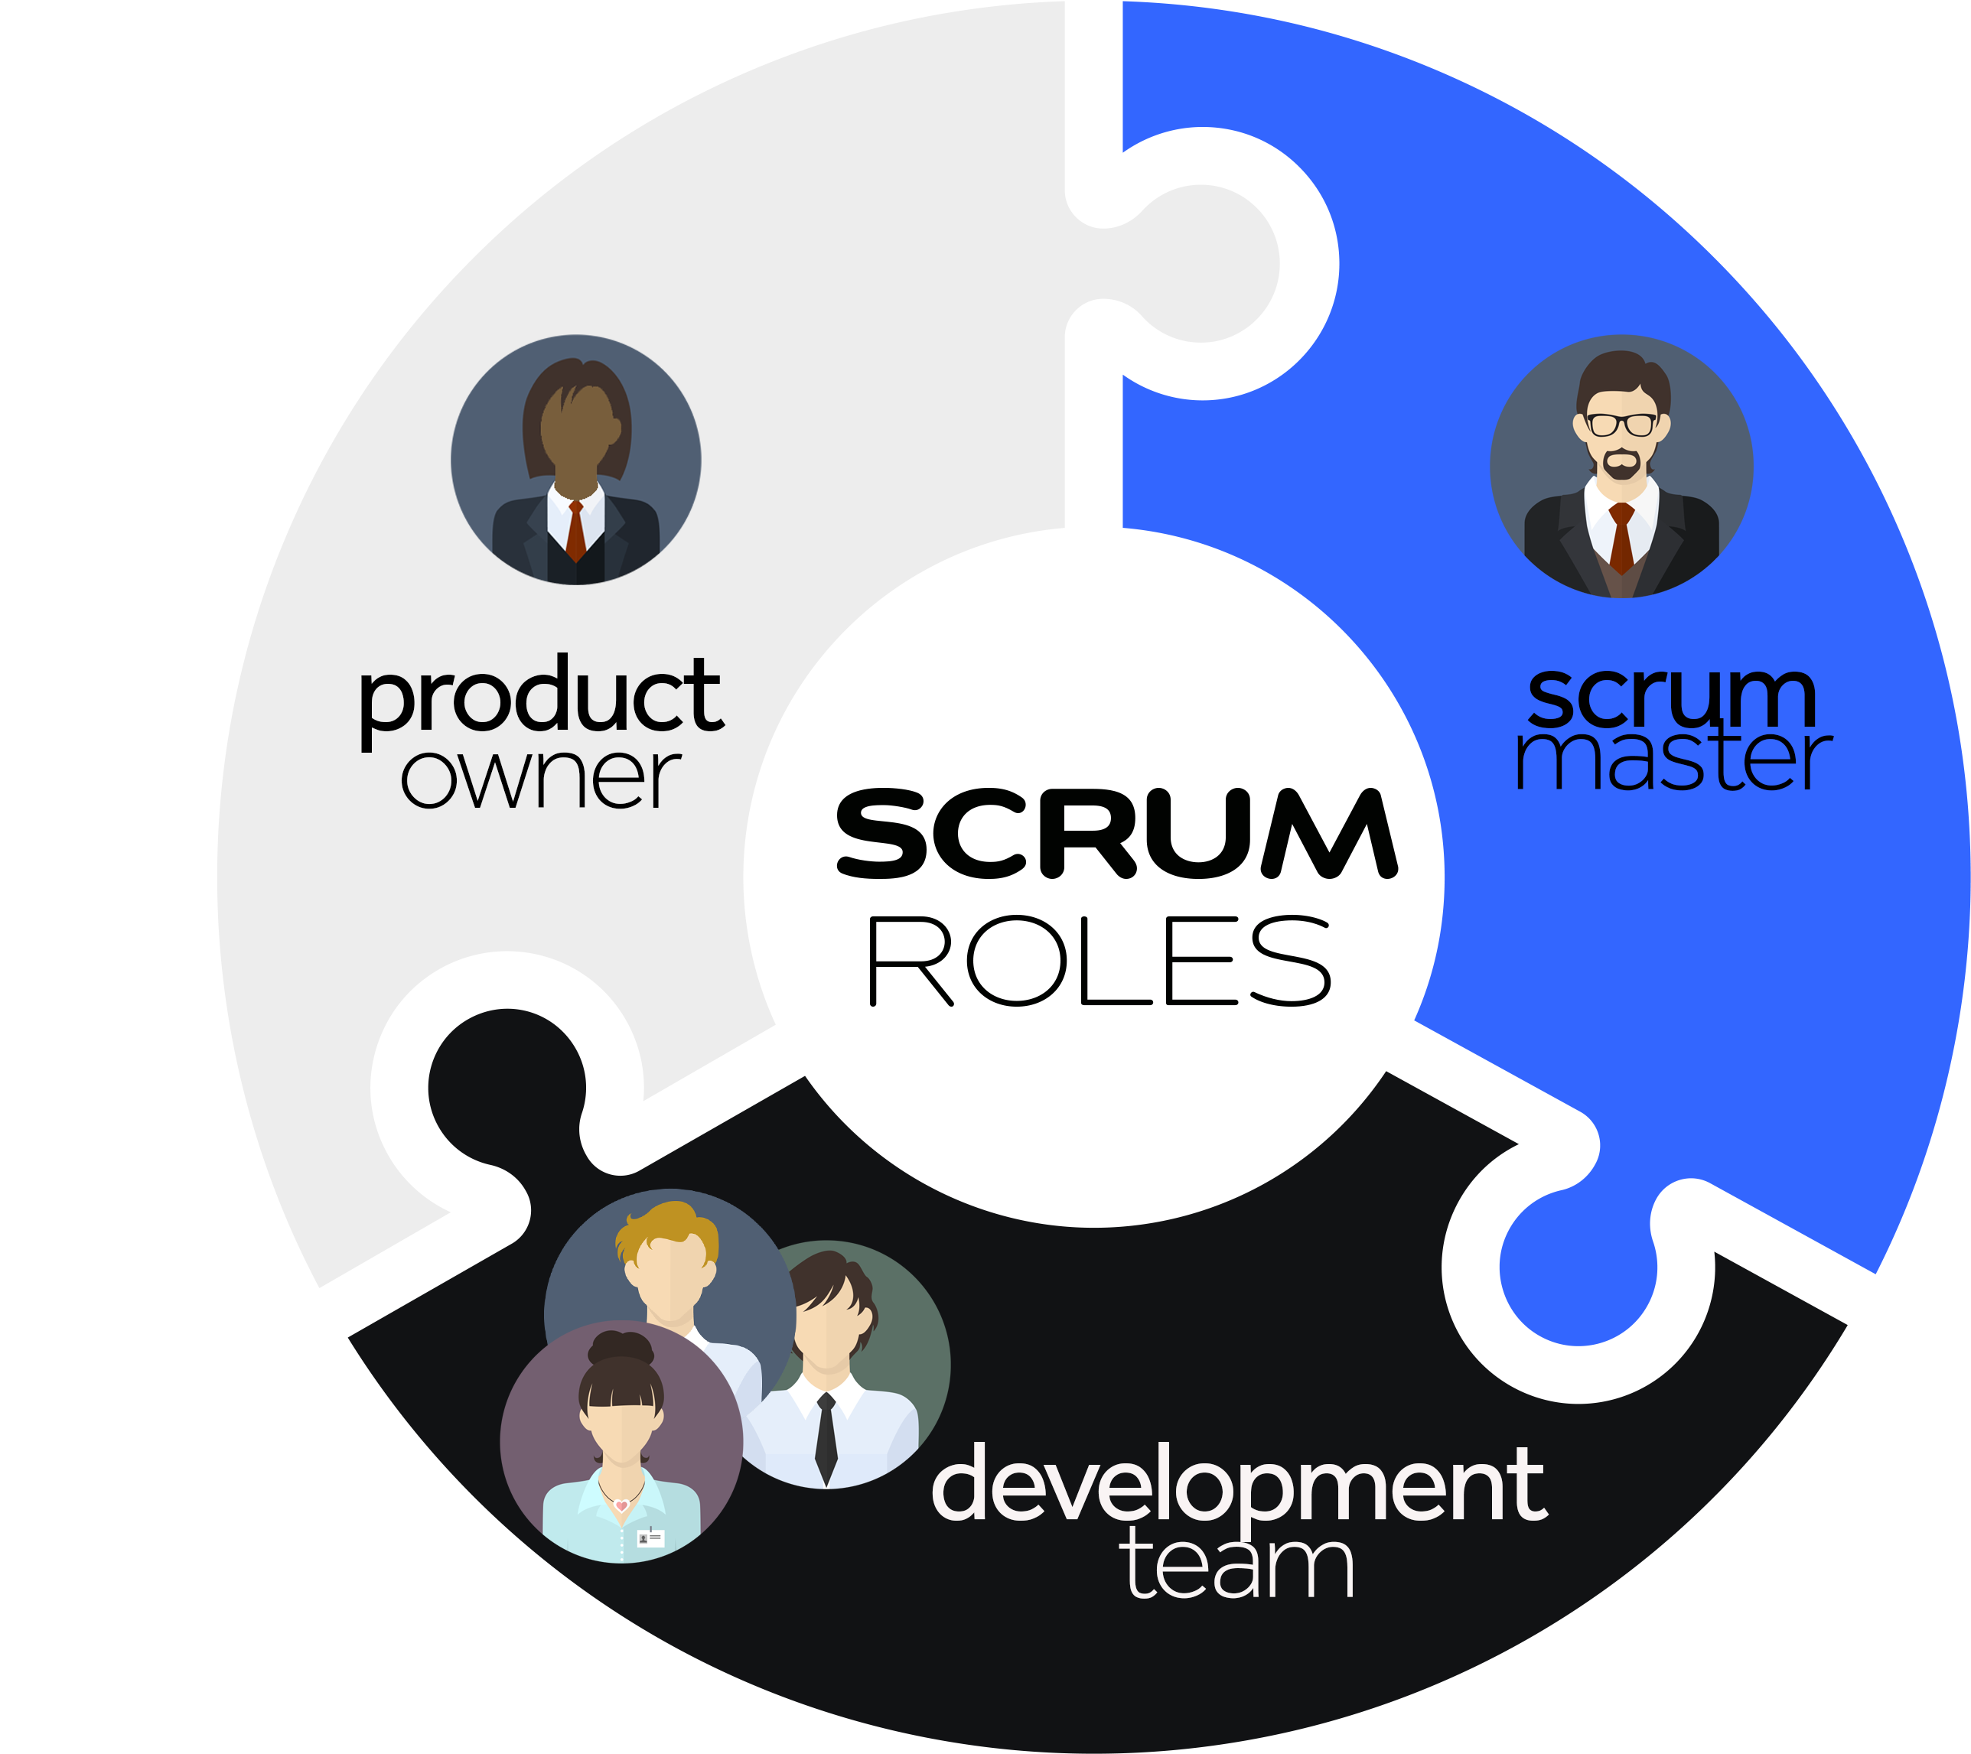

Slide 9
Product Owner
Ensures the team aligns with the product vision.
Responsibilities include the defining, refining, prioritizing the product backlog continuously.
Communicates with stakeholders and end clients and uses their feed back to help with the backlog grooming.

Slide 10
Scrum Master
Coaches and guides the team to follow the Scrum principles
Responsibilities include serving the team, the product owner, and organization.
Facilitates all scrum key events and ensures the key events are within adequate time.
Ensures the team understands the product backlog.

Slide 11
Development Team
The professionals who do the hands-on work and completes the tasks in a scrum work. They ensure that the sprint goal is made during each sprint.
Responsibilities include defining, refining sprint backlogs, showcasing the increment during the sprint review
Attributes include self-organizing and cross functional.

Slide 12
SCRUM Artifacts:
Product Backlog: The list of features and requirements of a product. This product owner is the one who defines the list, and it is constantly being re-vised, reprioritized, and revisited.
Sprint Backlog: The list of user stories or bug fixes that is selected by the development team.
Sprint Goal: The usable end-product of the sprint.

Slide 13
SCRUM KEY EVENTS
Backlog Grooming
Sprint Planning
Sprint
Daily stand ups
Sprint Review
Sprint Retrospective

Slide 14

SPRINT

Slide 15
SPRINT
The cycle of time where the scrum team works together to reach the sprint goal. Note that the sprint includes all the key scrum events from planning to sprint retrospective and daily stand ups.

Slide 16
BACKLOG GROOMING
This event is typically conducted by the product owner with assistance from the scrum master. It is where the product owner defines the product backlog, maintains it, and revises it. This enables the product owner to clarify the requirements for the product vision.

Slide 17
Sprint Planning:
This event is facilitated by the scrum master. This meeting is conducted with the development team and sometimes the product owner. This is where they will plan the upcoming sprint and the Sprint Goal will be defined. During sprint planning the product back-logs, sprint backlogs, and the product vision are emphasized.

Slide 18
Daily Stand Ups
This meeting is facilitated by the scrum master. It is a short event that happens at the same time on every working day. This event will iterate the sprint backlogs and ensure that everyone is on the same page. This event helps the scrum master to monitor the progress. They typically will answer the questions following questions:
a. What did we do yesterday?
b. What needs to be done today?
c. Is there anything impeding our goals?

Slide 19
Sprint Review
This event will happen at the end of the sprint. Stakeholders are typically invited. The product owner, scrum master, and the development team are all present. This is where the development team will showcase the product that was created during the sprint and shows all the backlog items that were implemented. This is where the product owner can decide if they want to deploy the product. It is also an opportunity for the product owner to revise the product backlogs.

Slide 20
Sprint Retrospective
This event is facilitated by the scrum master. This is where the developers and scrum master come together in a meeting and define what was done, what they should sustain on for the next sprint, and what and how they can improve on the next sprint.

Slide 21


Slide 22
SNHU Travel & SDLC
Ask the following questions:
Is this project small or large?
Are the requirements clear and stable, or could they change?

Slide 23
SNHU Travel & SDLC (Cont.)
The product vision: to gain a larger audience and upgrade the current system of SNHU Travel Agency to have niche vacation booking system.
Product backlogs include:
Booking vacation using outside systems like Delta Airlines(transportation), and Holiday Inn Suites(lodging).
EPIC: Implementing a mobile application with the information system website.

Slide 24
SNHU Travel & SDLC (Cont.)
The product vision states that SNHU travel wants to meet the customer’s needs. Because the needs could change the requirements are not stable.
Product backlogs require a lot of work to ensure functionality. For example, API services and other protocols are needed due connecting to outside systems. There are also a lot of nonfunctional and functional requirements when building a mobile app. There for this project is large.

Slide 25
SNHU Travel & SDLC (Cont.)
The Scrum Agile approach is most appropriate for SNHU travel because the project is large and needs to be adaptable to ensure we meet customer’s needs.

Slide 26
SNHU Travel & SDLC (Cont.)
It is a great idea we chose Scrum. After Christy had her focus group meeting with the stakeholders, she changed the product vision to expand clients for Wellness and Detox Vacations.

Slide 27
SNHU Travel & SDLC (Cont.)
With the Scrum approach we were able to implement the new changes! Deeming SNHU travel a success!

Slide 28


Slide 29
WORK CITED.
Agile Manifesto Values and principles. Agile Manifesto Values and Principles. (n.d.). Retrieved August 11, 2022, from https://resources.scrumalliance.org/Article/key-values-principles-agile-manifesto
Atlassian. (n.d.). Scrum - what it is, how it works, and why it's awesome. Atlassian. Retrieved
Aug11,2022from https://www.atlassian.com/agile/scrum#:~:text=Scrum%20is%20a%20framework%20that,and%20losses%20to%20continuously%20improve.
Cobb, C. G. (2015). The Project Manager's Guide to Mastering Agile: Principles and practices for an adaptive approach. John Wiley.
Valacich, J. S., &amp; George, J. F. (2018). Modern Systems Analysis and Design. Pearson.

